Slide 1
Credit card fraud detection
CAPSTONE PROJECT
Presented By:
BARATH.S
CARE COLLEGE OF ENGINEERING
MECHANICAL ENGINEERING

Slide 2
OUTLINE
Problem Statement
Proposed System/Solution
System Development Approach
Algorithm & Deployment
Result
Conclusion
Future Scope
References

Slide 3
Problem Statement
Develop an efficient credit card fraud detection system to accurately identify fraudulent transactions while minimizing false positives. The system should analyze transactional data in real-time and detect anomalous patterns indicative of fraudulent activity, thereby safeguarding the financial interests of cardholders and financial institutions. Key objectives include enhancing fraud detection accuracy, reducing the financial losses incurred due to fraud, and maintaining a seamless user experience for legitimate transactions.

Slide 4
Proposed Solution
The proposed solution involves developing a machine learning model trained on historical transaction data to detect patterns indicative of fraud. Techniques such as anomaly detection, supervised learning, or a combination thereof will be employed to identify suspicious transactions. The model will be continuously updated to adapt to emerging fraud patterns and improve detection accuracy over time.

Slide 5
System Approach
Data Collection and Integration
Data Preprocessing and Feature Engineering
Machine Learning Models
Real-Time Monitoring and Decisioning
Adaptive Learning and Model Updating
Behavioral Analysis and User Profiling
Rule-Based Systems and Thresholds
Integration with Fraud Management Systems
Reporting and Analytics
Compliance and Security

Slide 6
Algorithm & Deployment
For credit card fraud detection, a combination of supervised and unsupervised learning algorithms, as well as anomaly detection techniques, is typically employed. Supervised algorithms like Logistic Regression, Random Forest, and Gradient Boosting Machines are trained on labeled data to classify transactions as fraudulent or legitimate based on features such as transaction amount, location, and user behavior patterns. Unsupervised algorithms like Isolation Forest are used to identify anomalies in the data, which may indicate fraudulent transactions without the need for labeled examples. These algorithms are integrated into a fraud detection system that continuously monitors incoming transactions in real-time.
Deployment of the credit card fraud detection system involves serializing trained models into deployable formats and deploying them as real-time scoring services accessible through API endpoints. These services are containerized for scalability and deployed on cloud infrastructure like Kubernetes or AWS ECS for high availability. Robust monitoring and logging mechanisms are implemented to track the performance of deployed models, and automated pipelines ensure regular model retraining with fresh data. Security measures such as encryption protocols and authentication mechanisms are put in place to protect sensitive transaction data and prevent unauthorized access, ensuring the reliability and security of the deployed system.

Slide 7
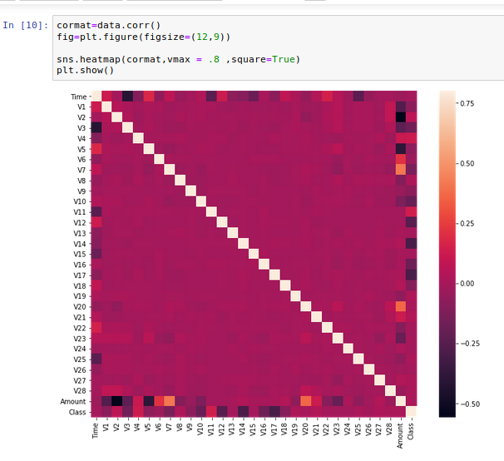
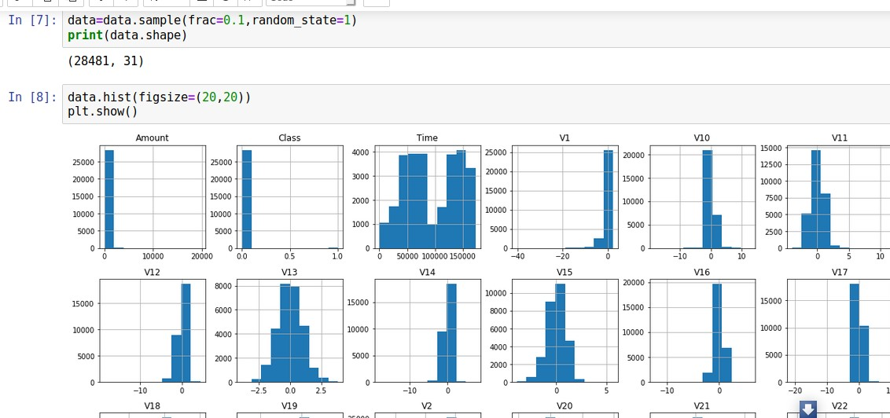
Result

Slide 8
Conclusion
In conclusion, credit card fraud detection is a critical task that requires a combination of sophisticated algorithms, real-time monitoring systems, and robust deployment strategies. By leveraging supervised and unsupervised learning algorithms, organizations can effectively identify fraudulent transactions while minimizing false positives and preserving the user experience. Deploying these algorithms as real-time scoring services on scalable and highly available infrastructure ensures timely detection of fraudulent activity. Continuous monitoring, automated retraining, and stringent security measures further enhance the reliability and security of the fraud detection system. With the ever-evolving nature of fraud tactics, ongoing refinement and adaptation of algorithms are essential to stay ahead of emerging threats. By implementing a comprehensive fraud detection solution, financial institutions can safeguard their customers' assets and maintain trust in the digital payment ecosystem.

Slide 9
Future scope
The future of credit card fraud detection lies in the convergence of advanced technologies such as artificial intelligence, machine learning, and behavioral analytics. As fraudsters employ increasingly sophisticated tactics, future systems will leverage predictive modeling, anomaly detection, and real-time monitoring to detect fraudulent activities with higher accuracy and efficiency. Biometric authentication methods and device fingerprinting techniques will enhance security, while blockchain technology will ensure transparency and immutability of transaction records. Collaborative efforts among financial institutions and regulatory bodies will foster information sharing and industry-wide cooperation to combat emerging threats effectively. Moreover, the integration of explainable AI will provide transparency and trustworthiness in fraud detection decisions, ensuring regulatory compliance and user confidence in the payment ecosystem. Overall, the future of credit card fraud detection holds the promise of a proactive, adaptive, and resilient defense against evolving fraud schemes.

Slide 10
References
A wealth of research exists on credit card fraud detection. For instance, "Credit Card Fraud Detection: A Realistic Modeling and a Novel Learning Strategy" by M. Nath and P. Nath (2016) discusses various modeling techniques and learning strategies. Another example is "Machine Learning Techniques for Credit Card Fraud Detection" by S. Bhattacharyya et al. (2019), which provides insights into machine learning algorithms for fraud detection. Additionally, "Anomaly Detection Techniques for Fraud Detection" by D. Bhattacharya et al. (2018) explores anomaly detection methods such as isolation forests and autoencoders. These references offer valuable insights into the state-of-the-art techniques, methodologies, and challenges in credit card fraud detection, serving as foundational resources for further research and development in the field.

Slide 11
THANK YOU

